Slide 1


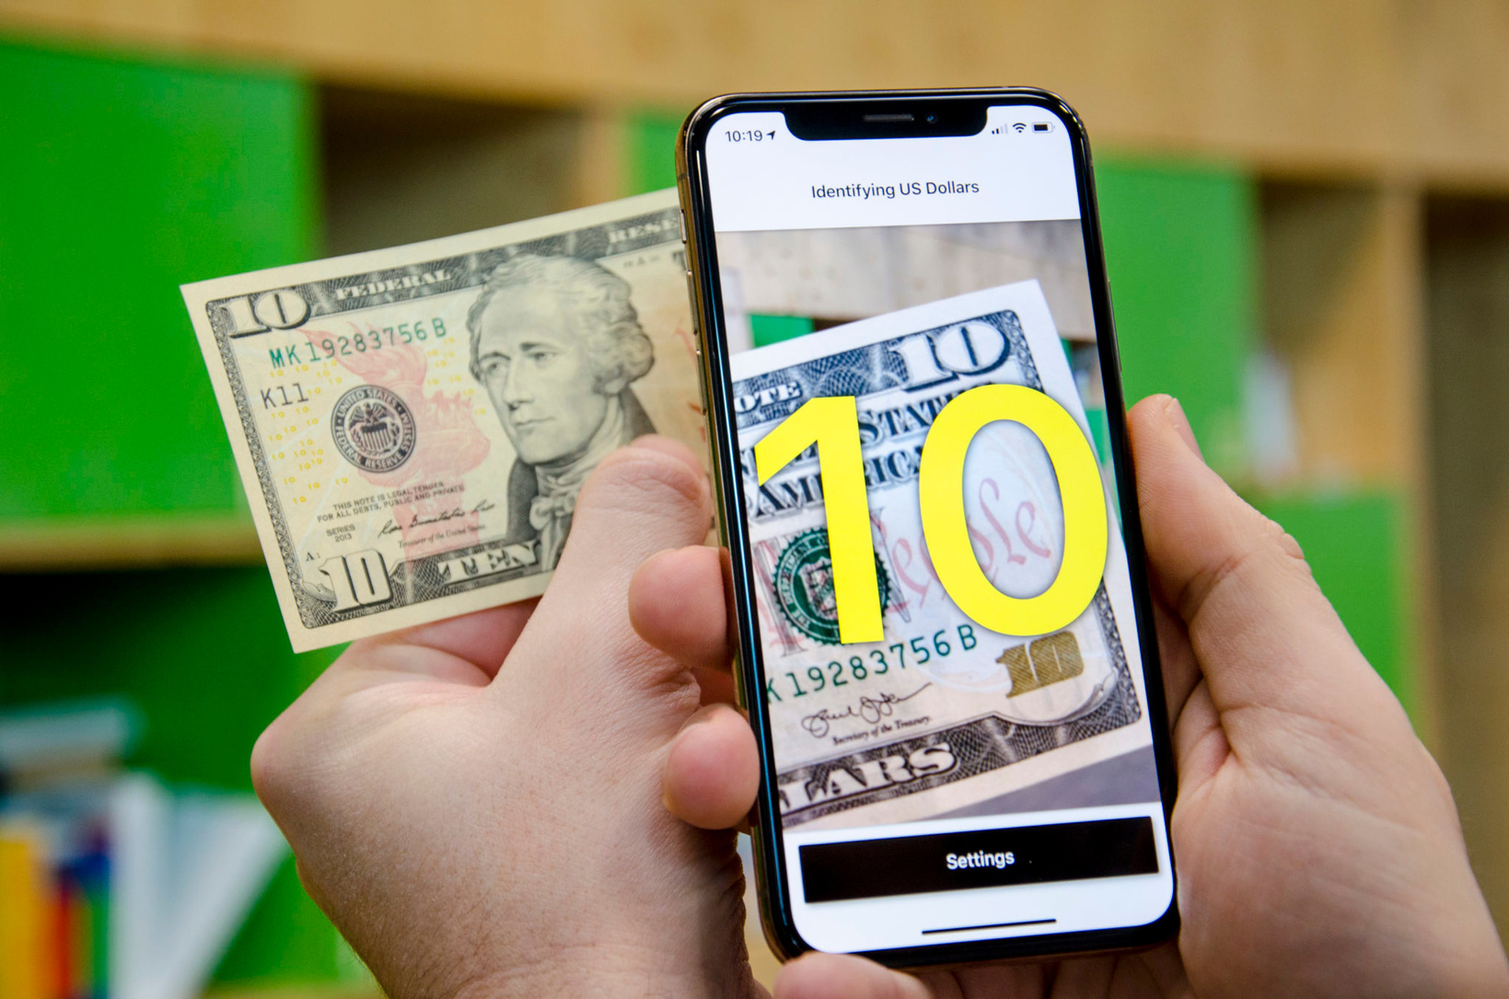

CURRENCY
DETECTION APP

Slide 2
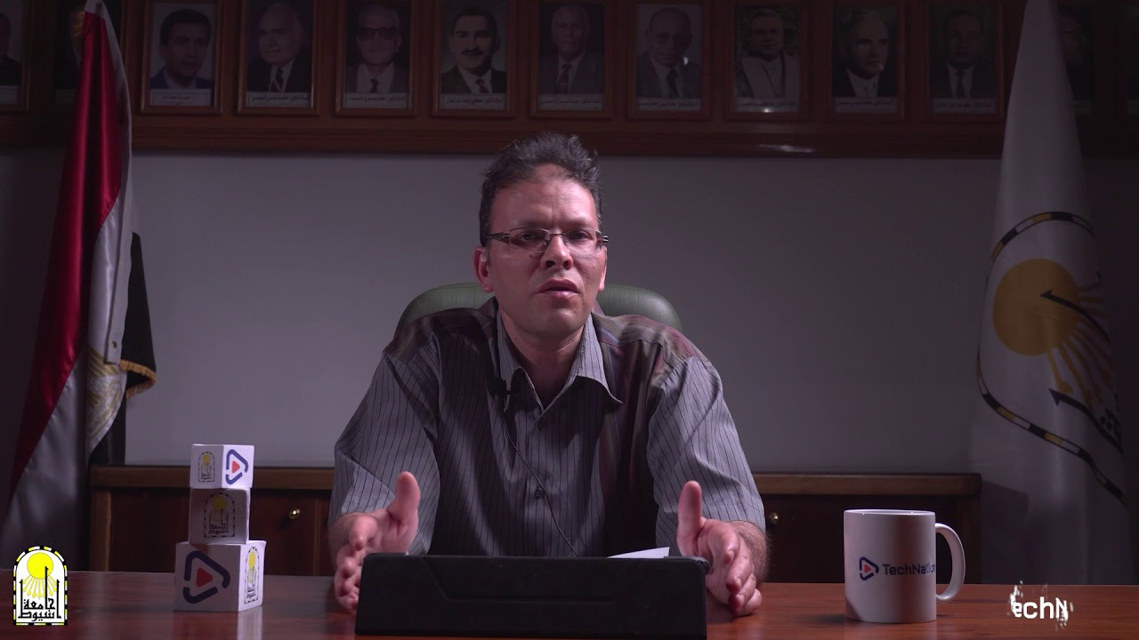

UNDER SUPERVISION
Dr: Khaled Fathy Hussein Salem
Professor and Vice Dean of the College of Computers and Information for Student Affairs
Eng: Nourhan khashaba
Teacher Assistant, Department of Information Technology at Egyptian E-Learning University (EELU)

Slide 3


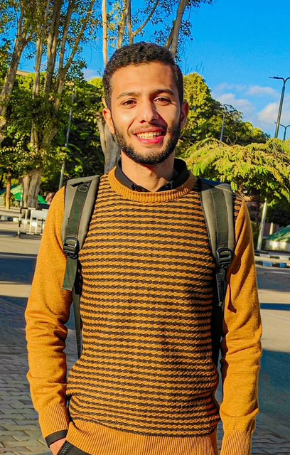
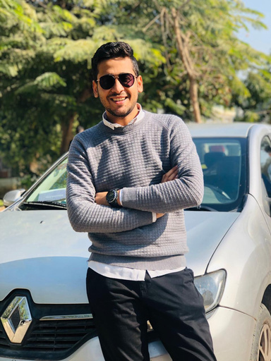
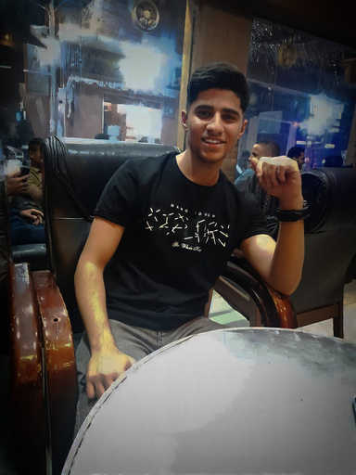
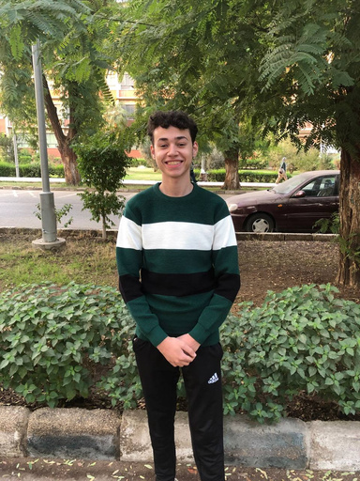
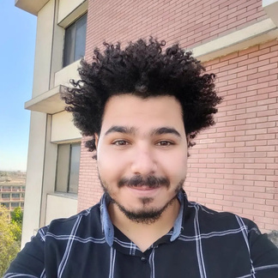
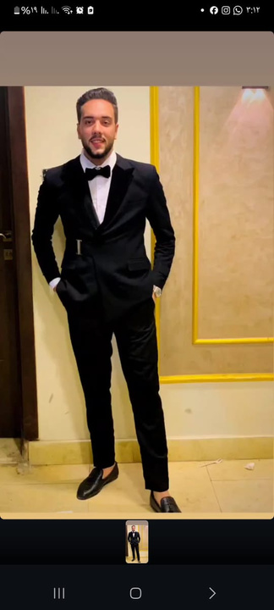
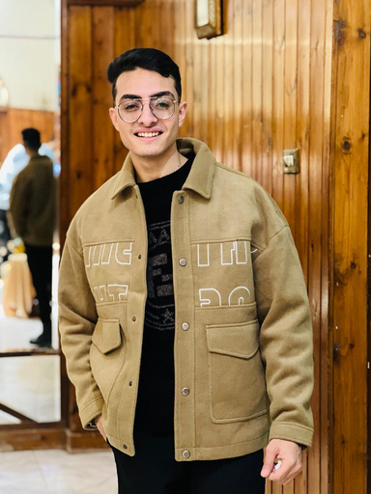
OUR TEAM
Mohamed Hosny Hassanien Desoky
Ahmed Mohamed Salah Gabr
Mohamed Hussein Ahmed Abdelkareem
Hassan Refaat Abdelrahman
Abdulla Mahmoud Ibrahim
Shady Shawky Shaker
Ahmed Sayed Mohamed
1

Slide 4

OUTLINE
01
02
03
Introduction
Related Works
Problem Statement
04
05
06
Problem Solutions
Requirements
Dataset
07
08
09
Technology
Methodology
Time Plane
10
11
12
Designs
References
Conclusion
2

Slide 5
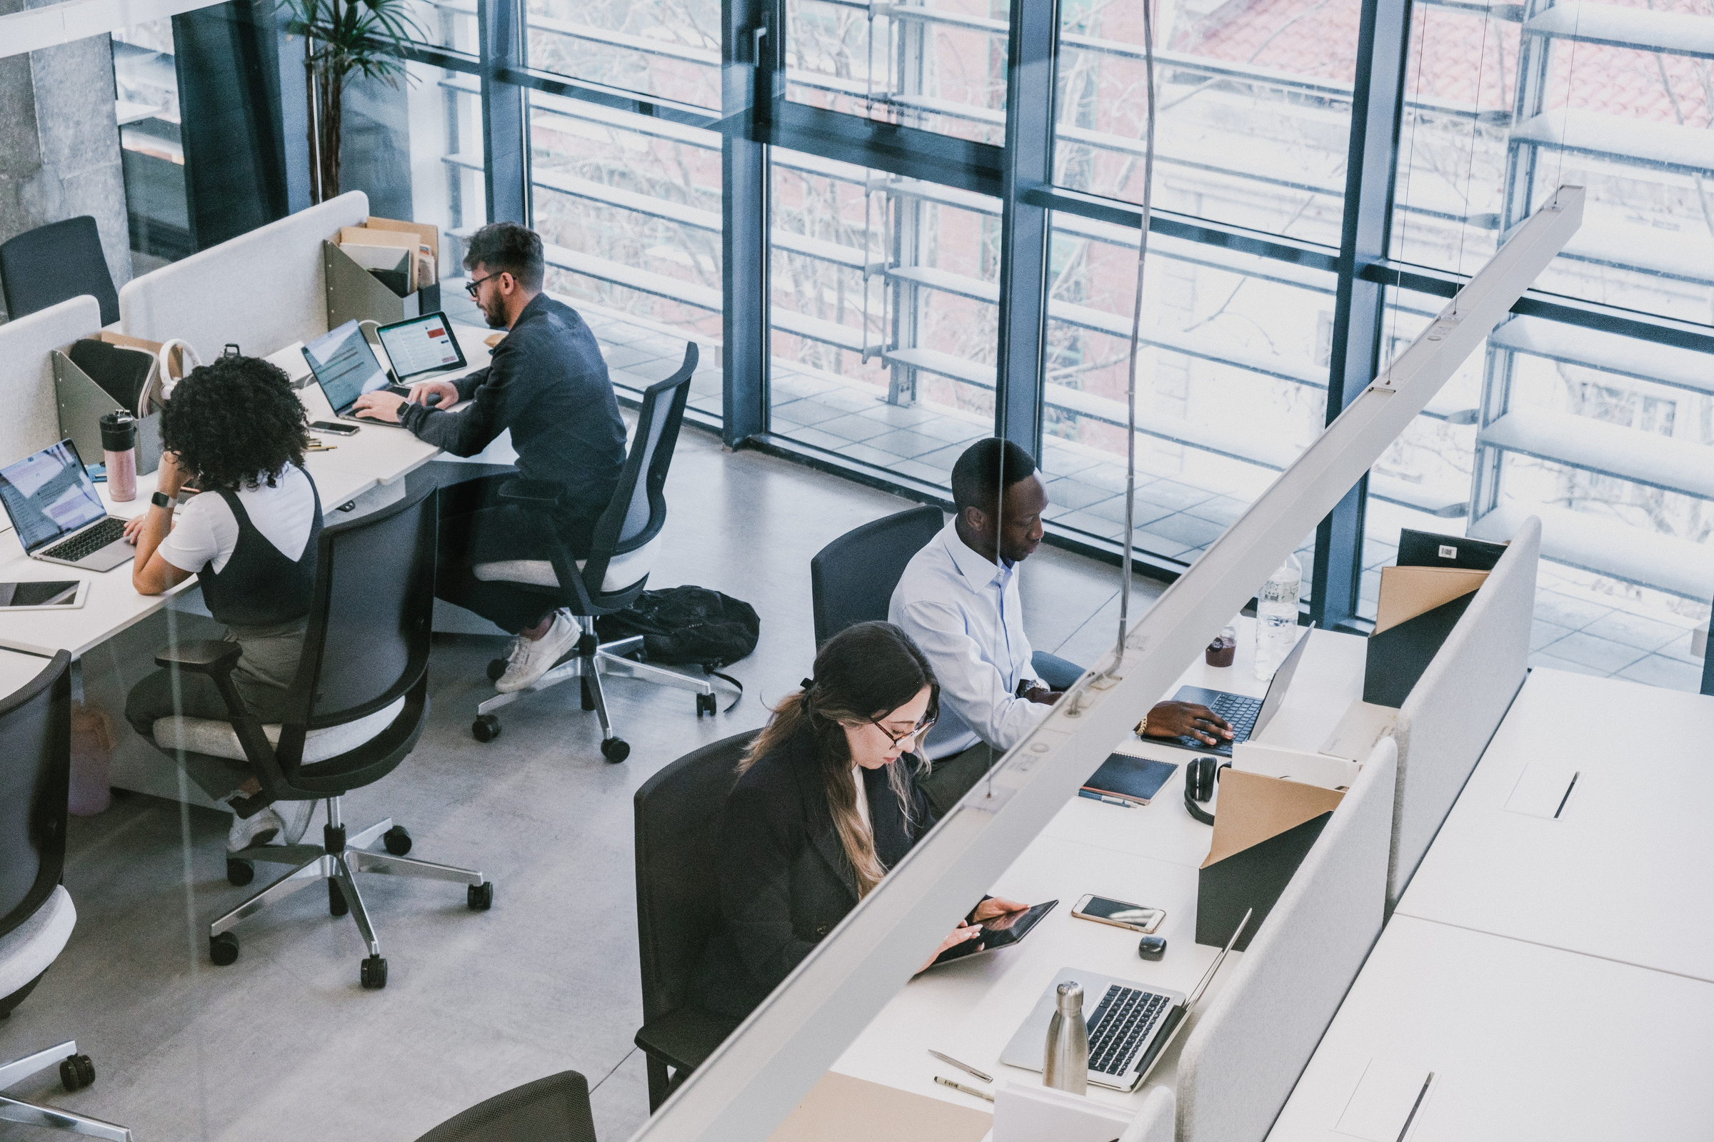



INTRODUCTION
•The project focuses on creating a cutting-edge mobile application designed to revolutionize the handling and identification of Egyptian currency. By harnessing the power of image recognition of Egyptian currencies with machine learning, this innovative app aims to enable users to easily discover and verify various denominations of Egyptian currency using their smartphone cameras.
•With a foundation rooted in cutting-edge algorithms and advanced computer vision technologies, this application seeks to provide real-time currency recognition capabilities, enhancing financial security and convenience for users. The project stands at the intersection of technology and practicality and aims to help people with visual impairment (the blind).
3

Slide 6

Why using mobile App ?
6.94 billion using mobile App in the world.
Easy to use and move around
4

Slide 7

0
Related Work
Cash Reader :
is the mobile app that identifies the largest number of world currencies: from Europe to Australia.
Assistive technology which reads money value aloud and with ease. Switch to silent mode and banknote denomination will be transformed into vibration. Use it in noisy places or when you need some privacy.
LOGO
5

Slide 8




PROBLEM STATEMENT
01
Current methods for identifying and Egyptian banknotes lack efficiency, accessibility and real-time capabilities.
The elderly and visually impaired (blind) people face many difficulties in recognizing and identifying currencies, which leads to inconveniences and potential risks in financial transactions.
02
6

Slide 9



CHALLENGES:
•Inaccurate Identification: often struggle with accurately identifying or distinguishing between various denominations of Egyptian currency notes.
•Limited Accessibility: Lack of accessible and user-friendly tools or apps for instant and reliable currency recognition impacts individuals' ability to efficiently handle Egyptian currency.
7

Slide 10

Problem Solutions
•The project aims to develop an easy-to-use mobile application equipped with the latest technologies for recognizing images of Egyptian currencies with machine learning capabilities.
•This app's primary goal is to enable users to swiftly and accurately identify different denominations of Egyptian currency notes using their smartphone cameras.
•The solutions include implementing advanced algorithms to recognize and process images of Egyptian currencies, ensuring an easy-to-use interface, and conducting comprehensive testing and security procedures.
8

Slide 11
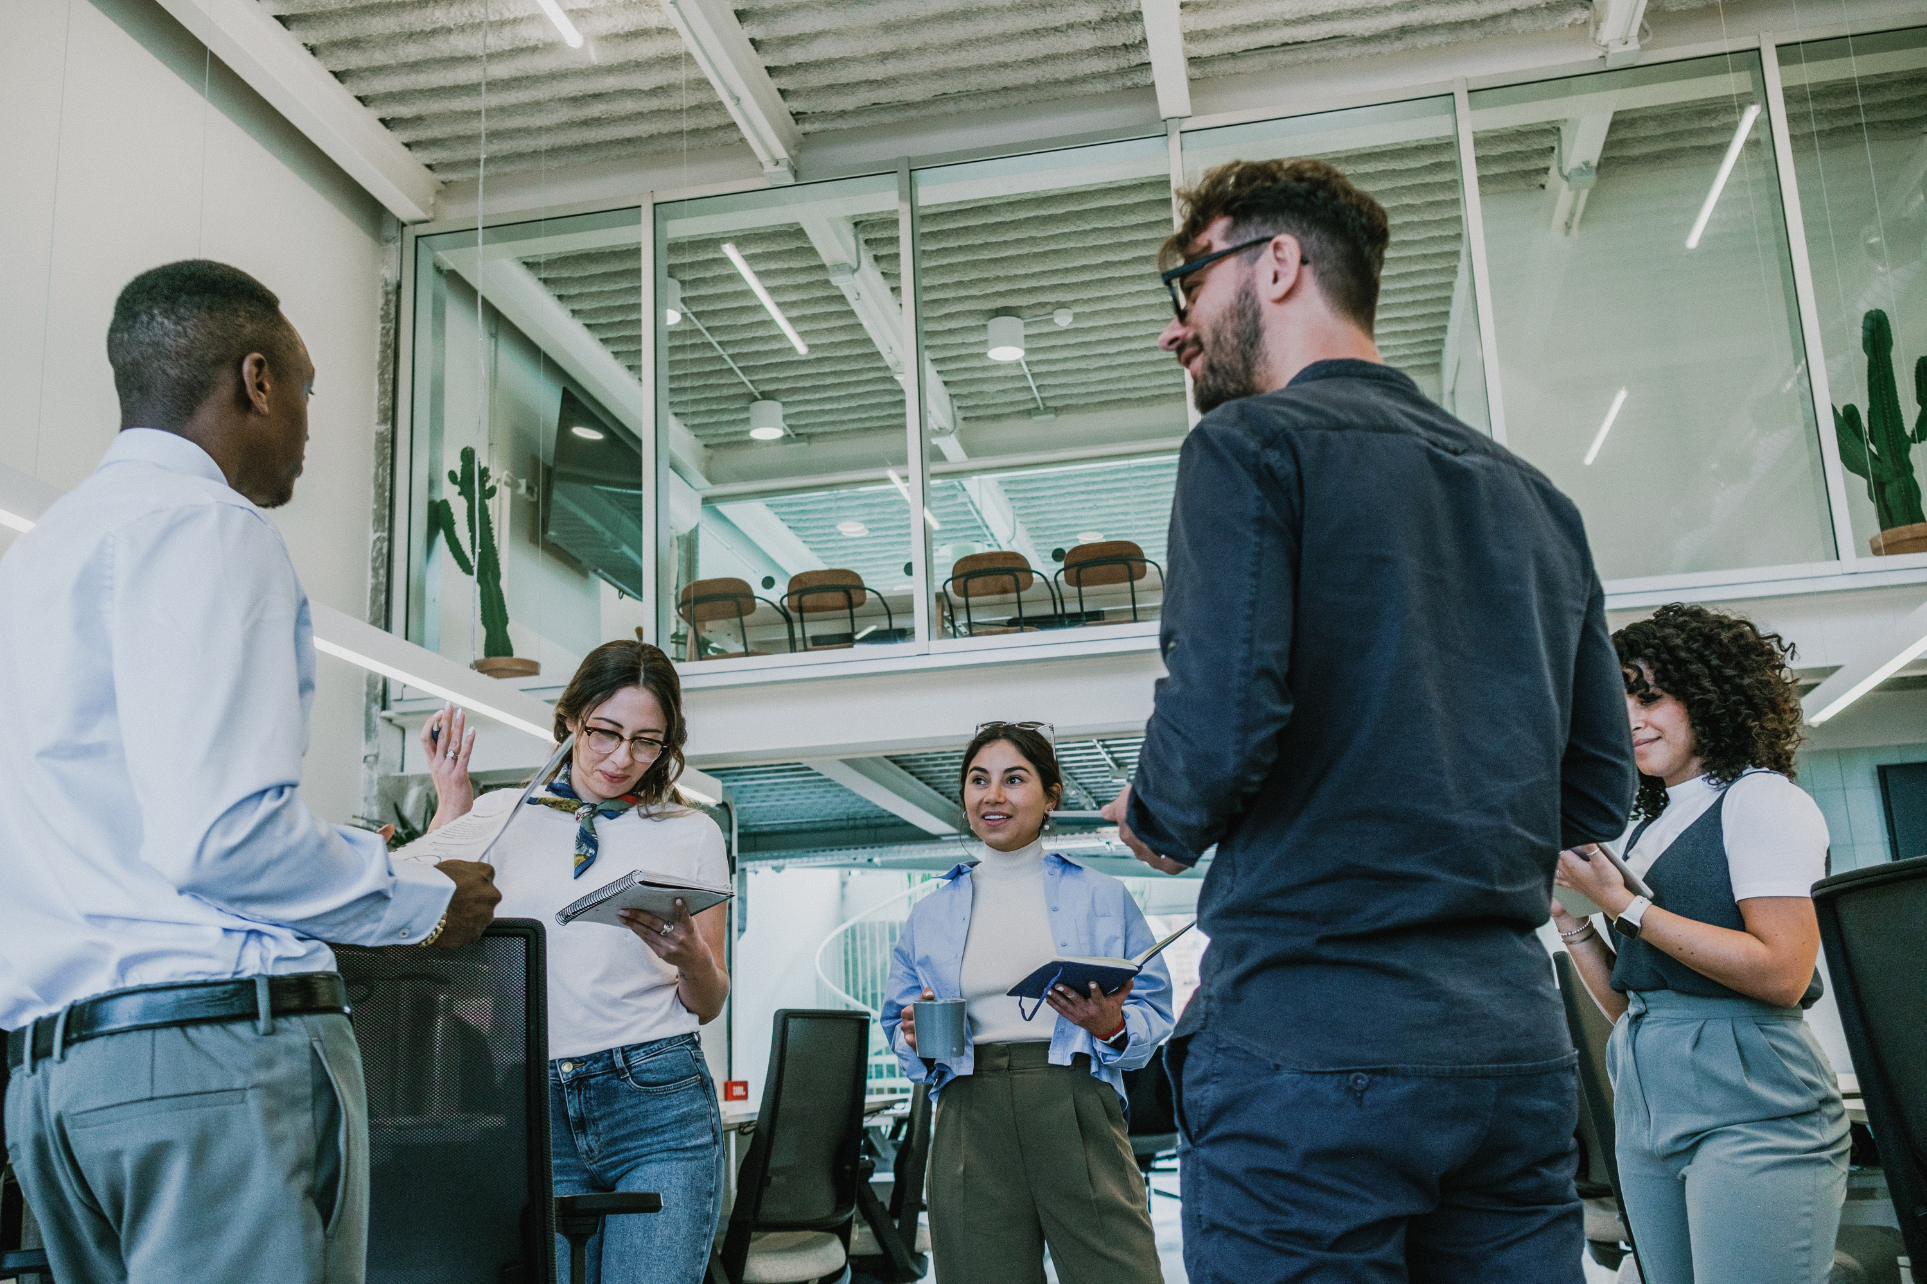
OBJECTIVES
•Developing a mobile application equipped with advanced Egyptian currency image recognition and machine learning capabilities to provide users with a reliable, real-time solution to accurately identify different denominations of Egyptian currency notes.
•The goal of the project is to help the visually impaired (blind) and be able to easily recognize images of Egyptian currencies by hearing the amount value from the mobile application.
•The goal of this project is to address these challenges by creating an intuitive and efficient mobile app capable of swiftly and accurately recognizing Egyptian currency .
9

Slide 12






REQUIREMENTS
Functional Requirements for project
Non-Functional Requirements for project
10

Slide 13


FUNCTIONAL REQUIREMENTS:
01
02
03
04
05
06
Accurate Identification: Recognize and differentiate Egyptian currency denominations.
Real-time Processing: Swiftly process images from the device's camera for instant feedback.
User Interface: Intuitive interface for image capture and displaying identification results.
Compatibility Function across various devices and be accessible to all users.
Testing and Quality Assurance: Comprehensive testing to validate functionality, accuracy, and performance.
Minimization of errors and bugs for smooth operation.
Data Security
Encrypt and protect user data and currency images.
11

Slide 14
NON-FUNCTIONAL REQUIREMENTS
01
02
03
04
Performance
Usability
Scalability
Documentation:
Fast and responsive operation without excessive resource consumption
Intuitive design for users of all technical levels
Ability to handle increased usage and adapt to future enhancements
Comprehensive user guides explaining app functionalities
12

Slide 15
Methodology
Define Project Objectives
User Research and Needs Analysis
Select Technology Stack
Data Collection
Data Preprocessing
Model Selection and Training
Accessibility Design
User Testing
13

Slide 16










1-The user can download the application easily.
2-We can insert the picture that contain currency in the application by taking photo by phone or insert it from his gallery
3-The application will extract the currency from the selected picture.
14

Slide 17

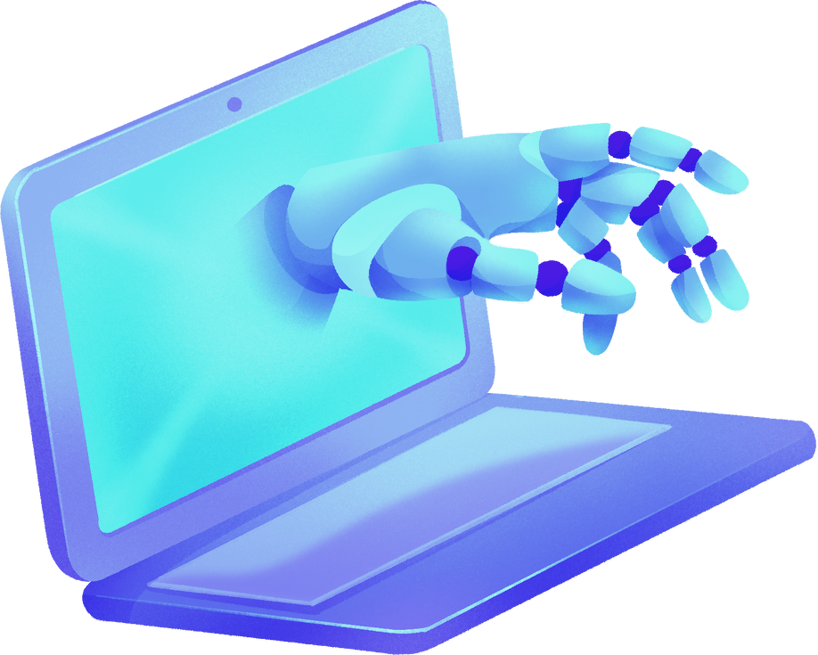
DEEP LEARNING
•We use pre-trained EfficientNet_Lite2 model.
comparison :
Model architecture | Test Accuracy | Model Size | Data set size | Number of classes
MobileNet_V2 | 85.4% | 8.9MB | 8000 | 8
EfficientNet_Lite2 | 91.5% | 18.2MB | 8000 | 8
15

Slide 18
DEEP LEARNING
EfficientNet uses a technique called compound coefficient to scale up models in a simple but effective manner. Instead of randomly scaling up width, depth or resolution, compound scaling uniformly scales each dimension with a certain fixed set of scaling coefficients. Using the scaling method and AutoML, the authors of efficient developed seven models of various dimensions, which surpassed the state-of-the-art accuracy of most convolutional neural networks, and with much better efficiency.
nunc sit amet augue. Quisque ante magna, varius et vehicula congue, viverra eu nulla.
16

Slide 19
Classes names
Class id | Class name
01 | 5 pounds
02 | 10 pounds
03 | 20 pounds
04 | 50 pounds
05 | 100 pounds
06 | 200 pounds
07 | New10 pounds
08 | New20 pounds
17

Slide 20

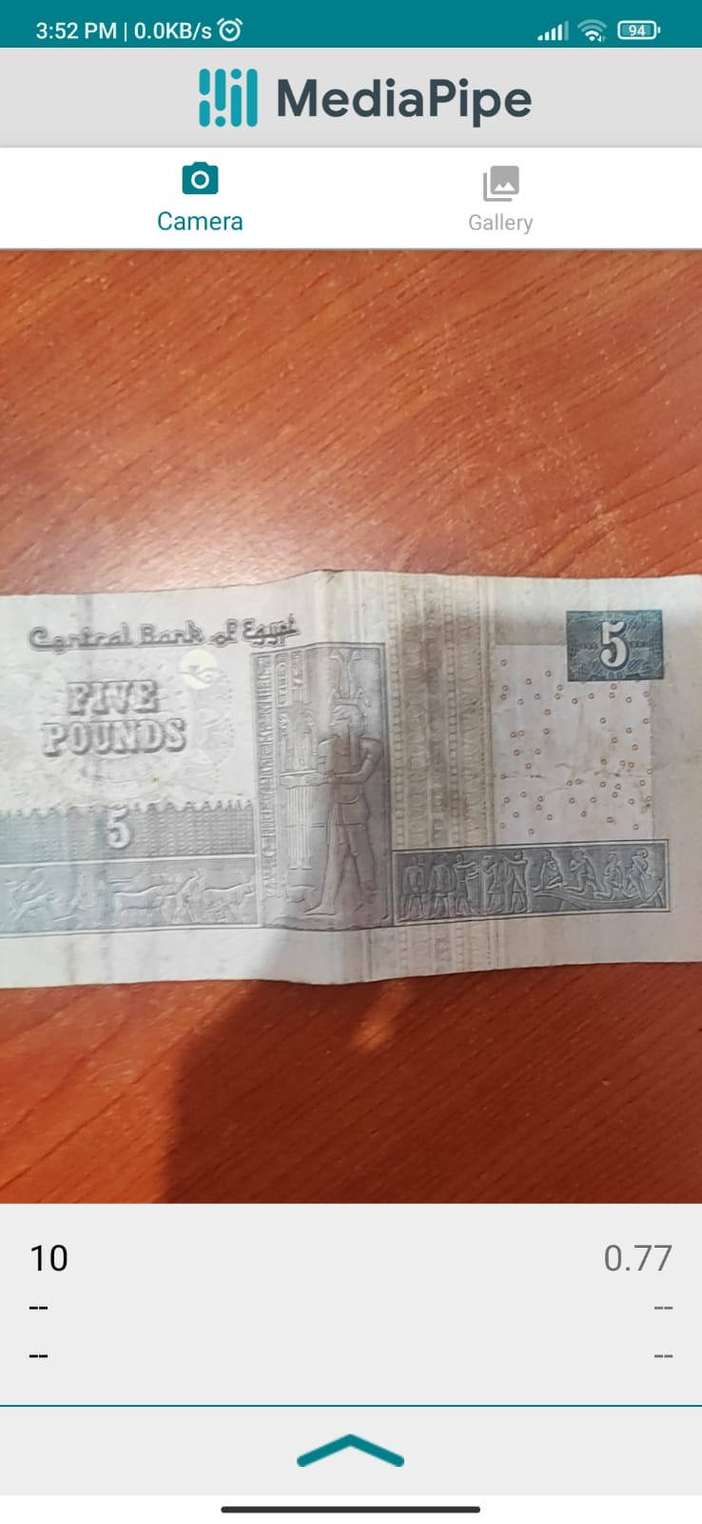
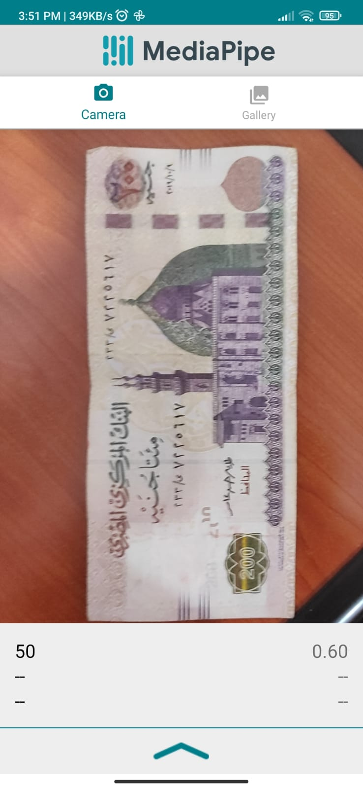
The prediction
The first prediction
18

Slide 21
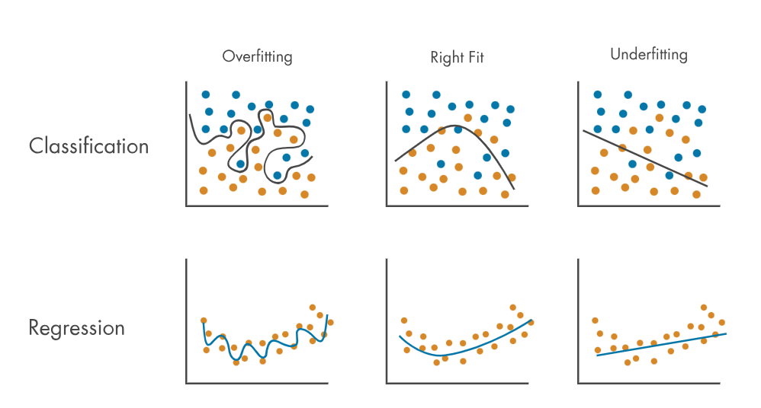
Problems encountered in the model
Overfitting
is an undesirable machine learning behavior that occurs when the machine learning model gives accurate predictions for training data but not for new data. When data scientists use machine learning models for making predictions, they first train the model on a known data set.
19

Slide 22
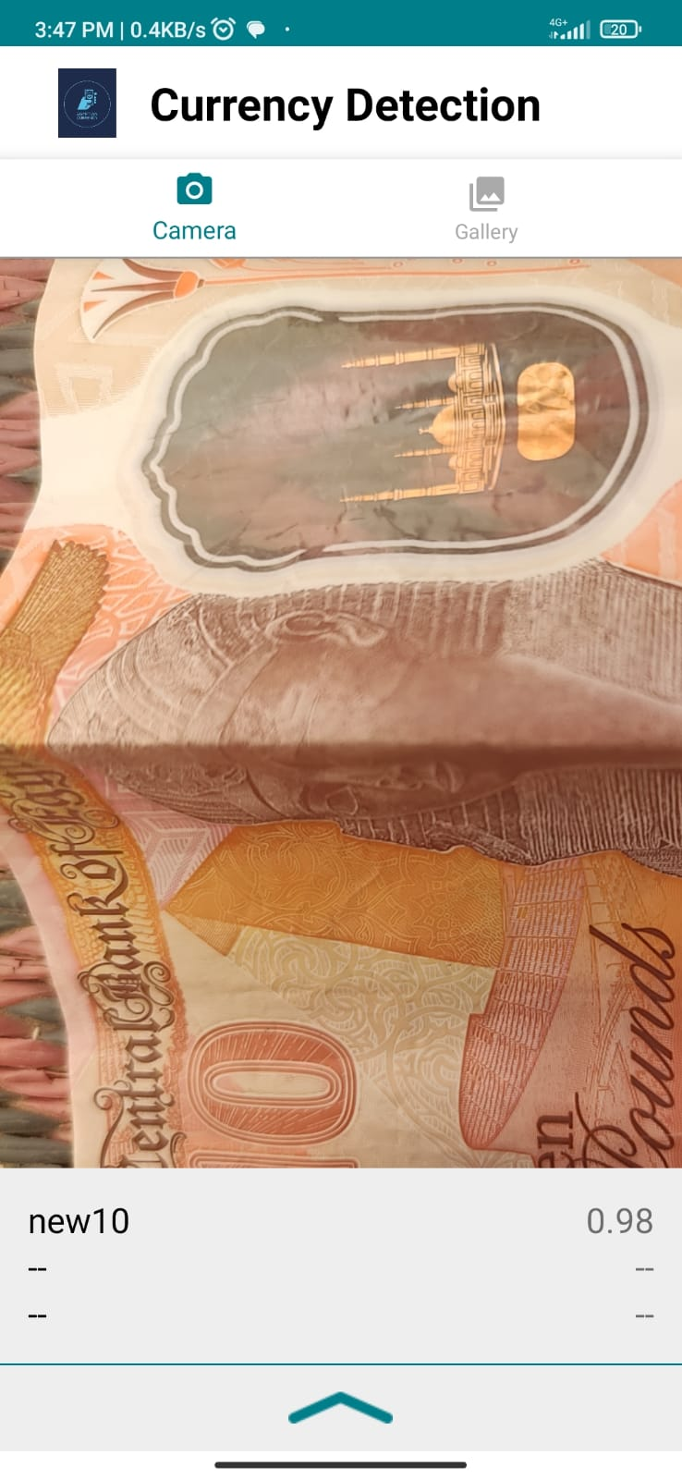
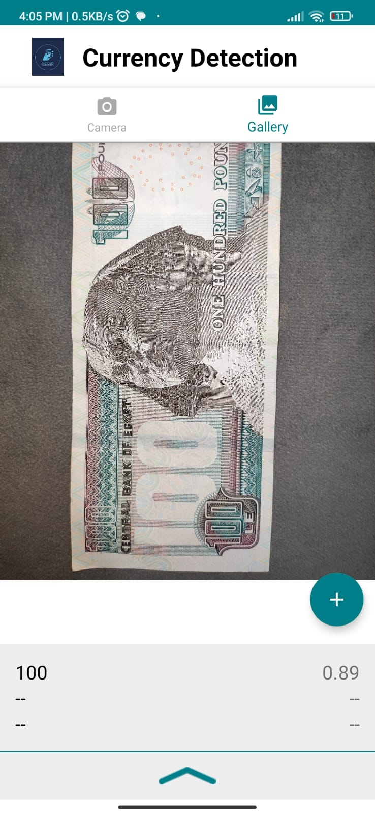
The prediction
The second prediction
This is the prediction process after using another model(EFFICIENTNET_LITE2)
We use data augmentation to increase dataset
Increase with epochs to increase accuracy
fixed Overfitting bug
20

Slide 23
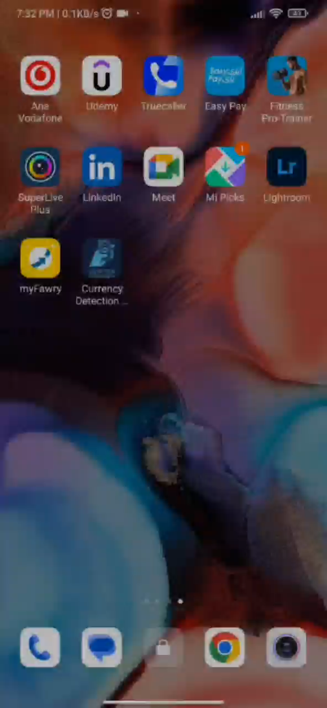
The prediction
Explanatory video
21

Slide 24



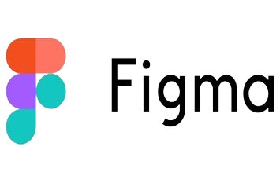



Technology
22

Slide 25
Why using MediaPipe
MediaPipe is an open-source library by Google for building computer vision and machine learning applications. It provides pre-built components for tasks like face detection and hand tracking, is optimized for real-time performance, supports various platforms and devices, and integrates well with machine learning models. It's commonly used for applications like augmented reality, gesture recognition, and object detection.
23

Slide 26


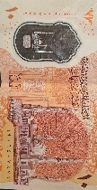
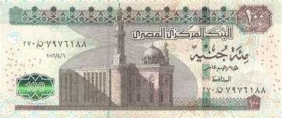
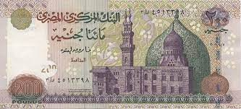
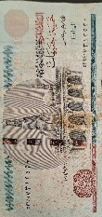
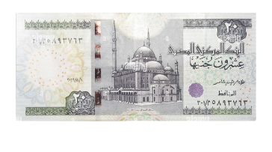
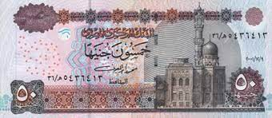


Dataset
https://drive.google.com/drive/folders/1Hl2y99notXxGE26N59pvVUYI4MJ1Rflo
24

Slide 27

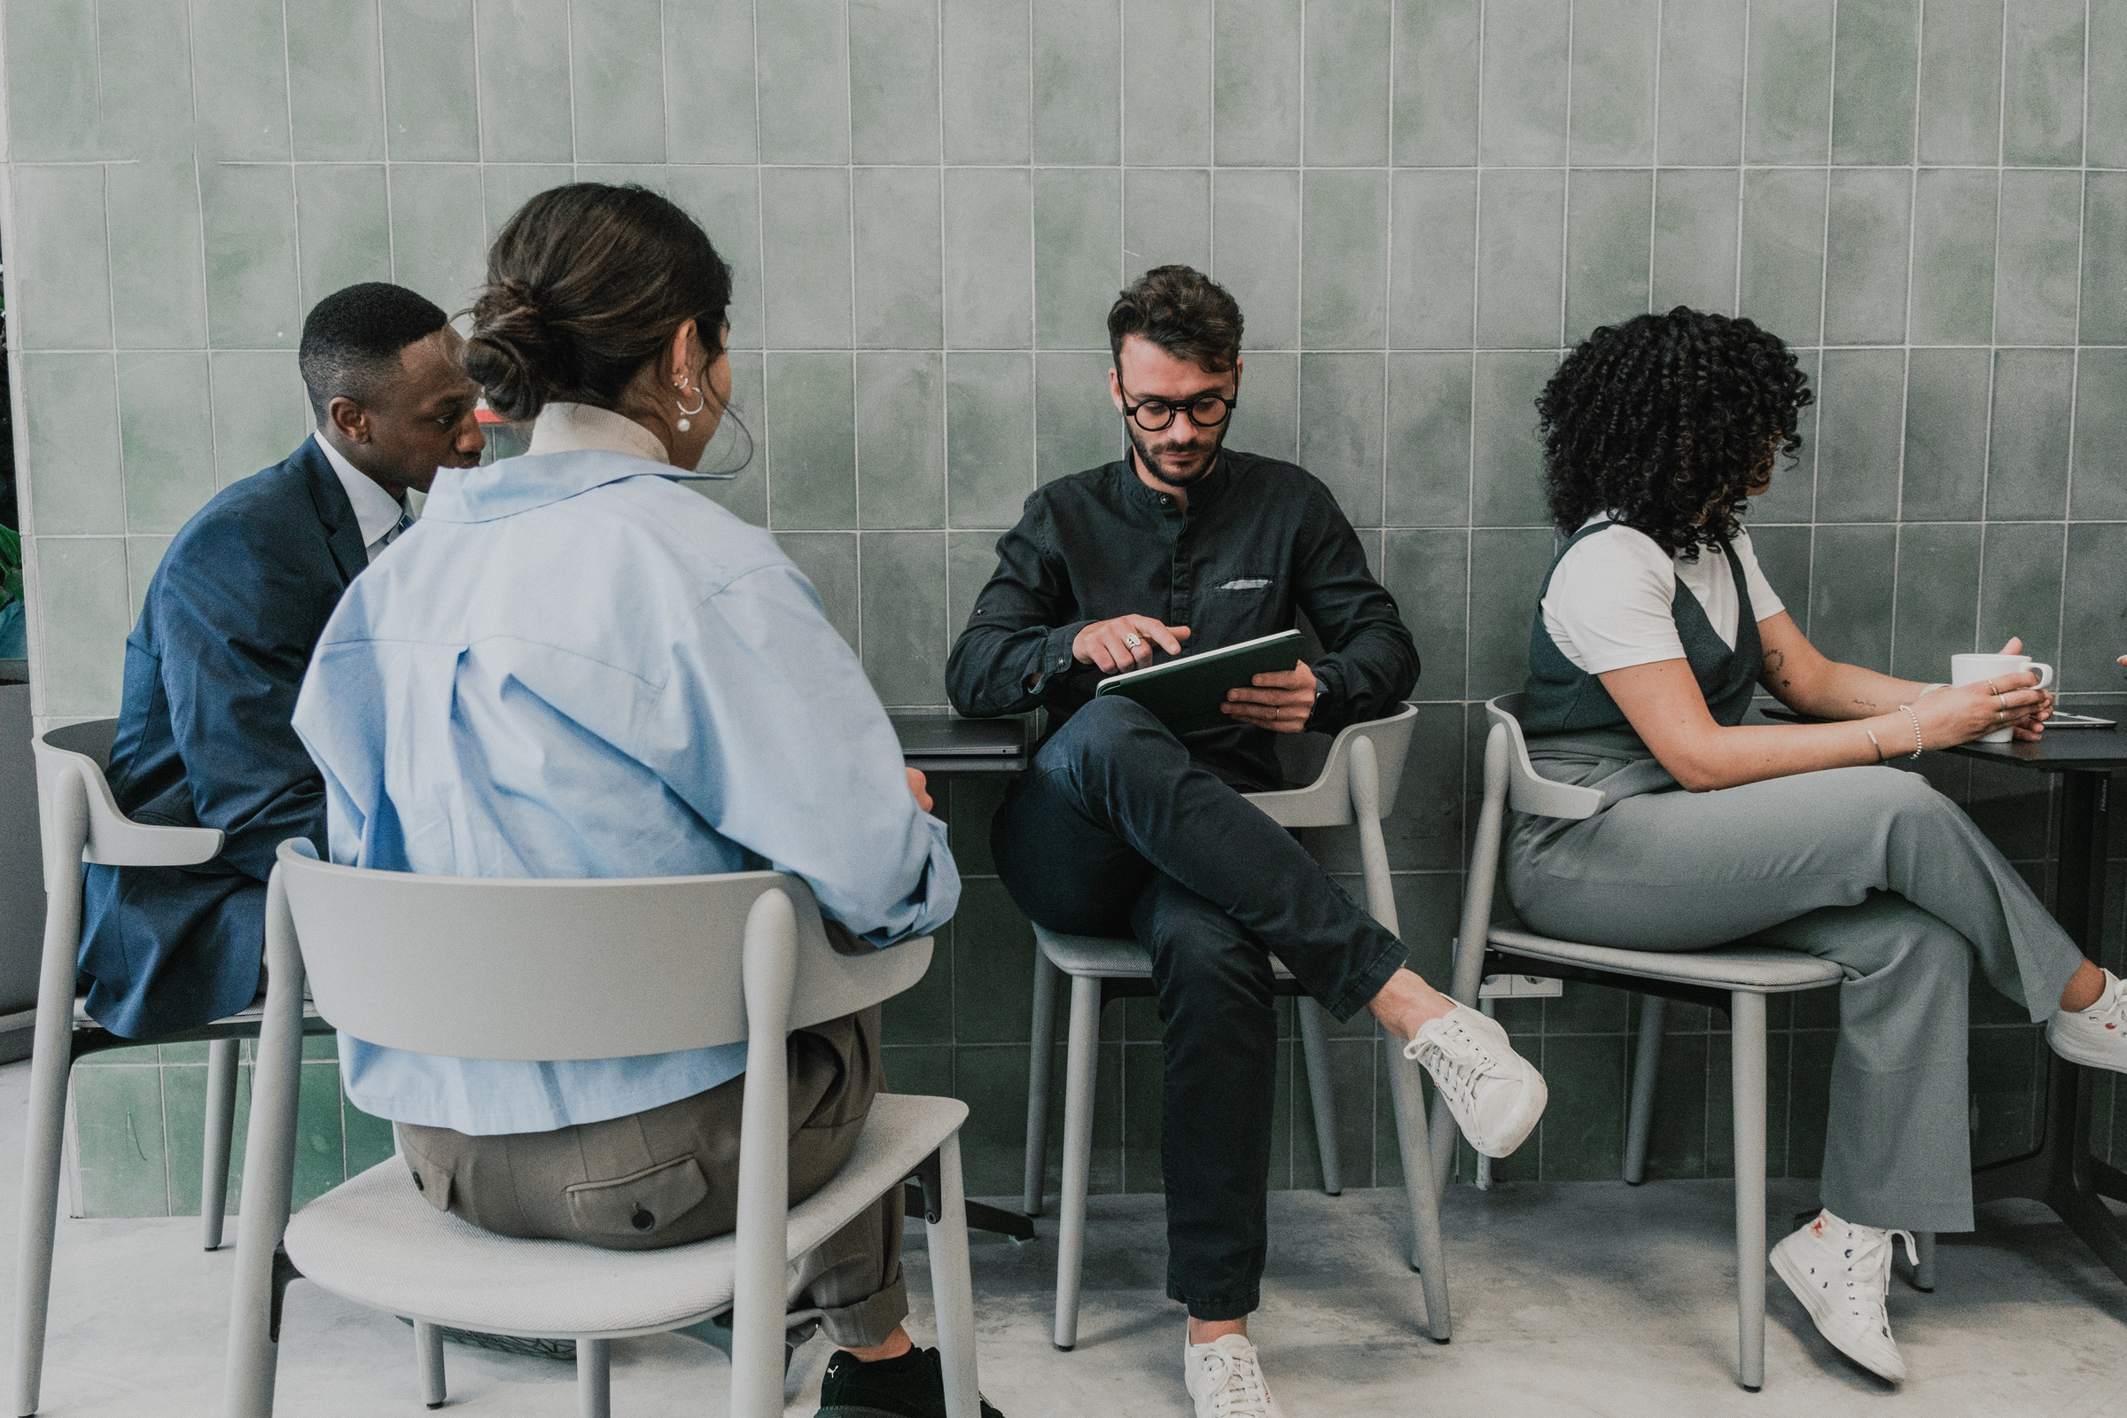
TIMEPLANE
We chose the idea and began to see the resources and needs we needed, then we began to study, after we divided the work and began to implement it.
25

Slide 28

First Semester
Oct-Nov
Planning and Research
•Preamble, Problem Background, and Statement
•Significance of the Project and Objectives
• Project Scope, Requirements, and Limitations
Development
•Data Collection and Preprocessing
•Machine Learning Model Development and Training
•Mobile App Interface Development
Dec- Feb
Second Semester
Testing and Refinement
•Integration and Testing of Image Recognition
•Real-time Processing Implementation and Testing
Authentication and Security Features Integration
Mar -May
Jun
Documentation and Finalization
•Project Report Compilation
•Final Testing and Quality Assurance
26

Slide 29



The second part of the project
we did 3 parts
Step1
Step2
Step3
Application
.
Add sound
Edit model
27

Slide 30
Step 1
I utilized CameraX for live detection. CameraX is a powerful library that makes it easy to access camera features and integrate them with machine learning models for real-time image and video processing.
Step1
Application
I used MediaPipe to integrate a machine learning model into the app. MediaPipe helped process and analyze live video streams to make real-time predictions and detections.
28

Slide 31
Step 2
Step2
Add sound
To add audio feedback, I implemented the speech.tts.TextToSpeech package. This feature converts text to spoken words, making the app more interactive and user-friendly.
29

Slide 32
Step 3
Step2
Step1
Step3
Edit model
work to modify and improve the model to increase efficiency and facilitate identification of currency
30

Slide 33
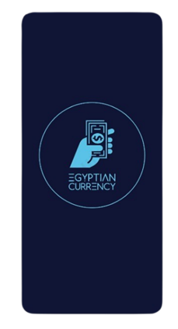
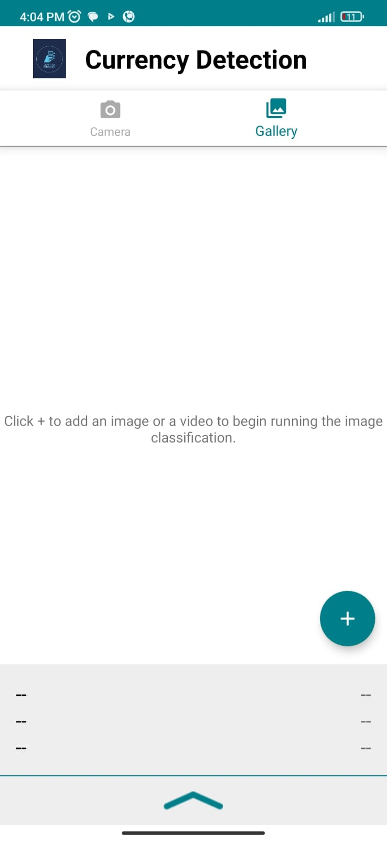
Designs
Splash Screen
Home Screen
31

Slide 34
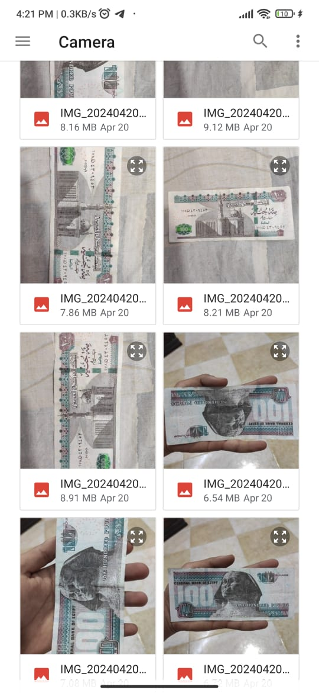
Designs
Gallery
Camera
32

Slide 35

References
1
https://mediapipe-studio.webapps.google.com/home
2
https://colab.google/
3
https://ai.google.dev/edge/mediapipe/solutions/vision/image_classifier
4
https://remove.bg/upload
5
https://www.kaggle.com/datasets
6
https://www.tensorflow.org/lite
7
https://developer.android.com/

Slide 36

The development and implementation of the currency detection mobile app utilizing Media Pipe have been a significant endeavor with several noteworthy outcomes. The project aimed to address the need for accurate and real-time identification of Egyptian currency notes, enhancing financial security and convenience for users.
Conclusion

Slide 37

Thanks!

